Slide 1
Happy 100th Birthday
ARRL!
©ARRL 2013 V3.0

Slide 2
The ARRL Celebrates its 100th Birthday
in 2014

Slide 3
To celebrate this milestone,
The ARRL Centennial
Convention
will be held in
Hartford, Connecticut
July 17-19, 2014

Slide 4
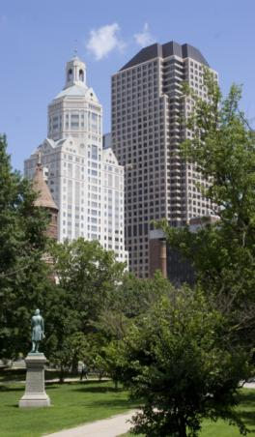
Why Hartford?
The ARRL was established in Hartford in 1914.
ARRL Headquarters and
W1AW are located in nearby Newington, Connecticut.
New England has many places
that are of historical significance to radio.

Slide 5
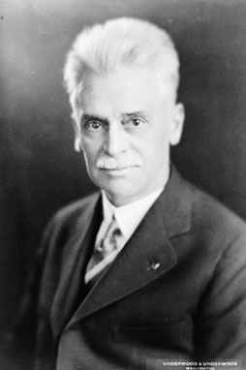
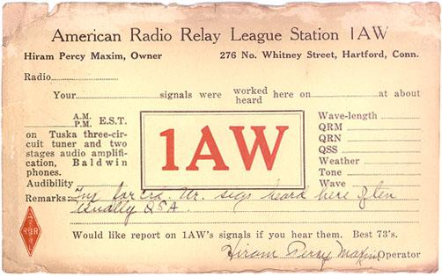

Slide 6
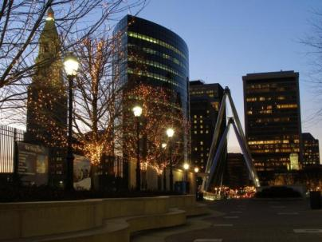
Why Hartford?
The Connecticut Convention Center is easily accessed from major interstates and airports.
Hartford is located between New York City and Boston.
The Hartford region
has a wealth of hotels, restaurants and other world-class attractions.

Slide 7
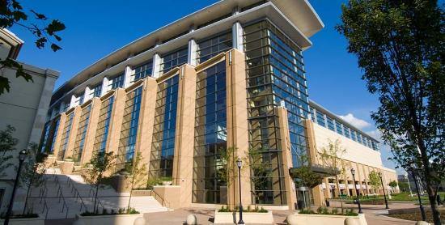
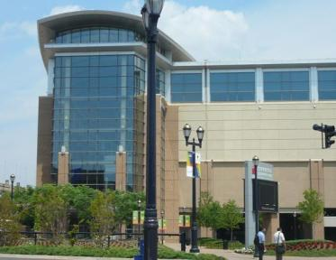
The Centennial Convention will be held
at the Connecticut Convention Center

Slide 8
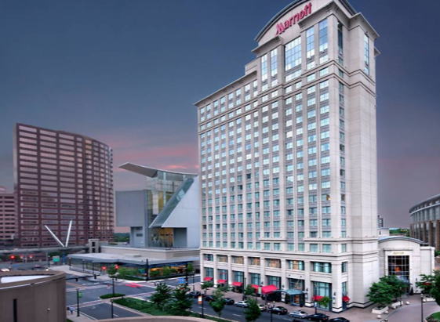
The Hartford Downtown Marriott
is the Headquarters Hotel and it is
attached to the Convention Center
Other hotels will be offering discounted
rates to convention attendees.

Slide 9
Other Hotels are offering discounted rates ARRL2014.org for details.

Slide 10
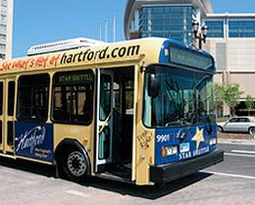
The Connecticut Convention Center
is located 15 minutes from
ARRL Headquarters.
Free shuttle buses will be available
between the two locations.

Slide 11
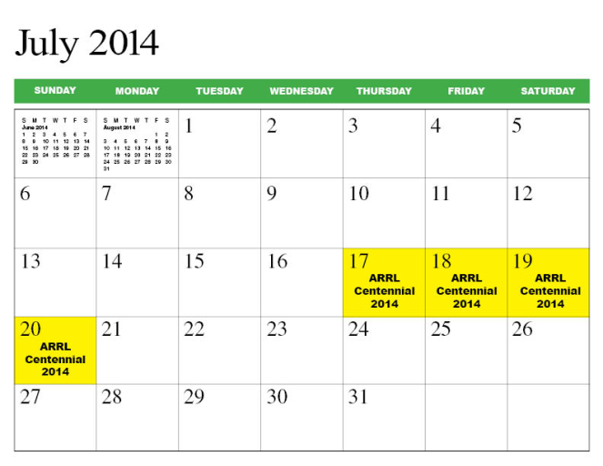
ARRL Centennial Convention

Slide 12
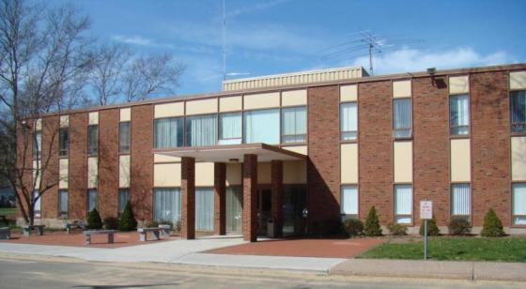
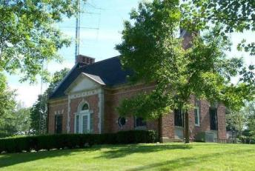
Visit ARRL Headquarters
and W1AW

Slide 13
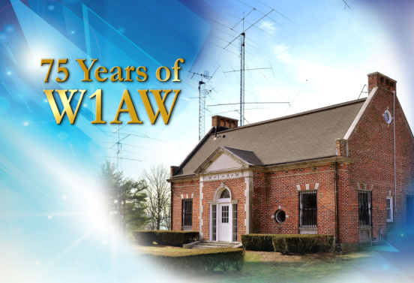
ARRL Headquarters and W1AW
Will Be Open the Weekend
of the Convention
The Hiram Percy Maxim Memorial Station

Slide 14
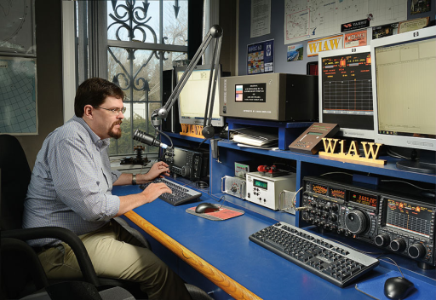
W1AW Will Be Open
for Guest Operators

Slide 15
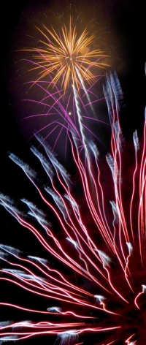
ARRL Centennial Convention
A Once in a Lifetime Opportunity to Celebrate
ARRL’s 100th Birthday
Have Fun and a Great Time!
Enjoy First Rate Exhibits
Hear VIP Speakers and Presentations
Attend National Meetings for Amateur Radio Groups and Organizations

Slide 16
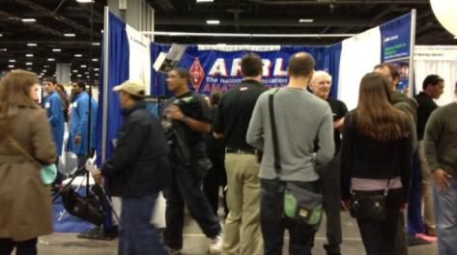
ARRL Centennial Convention
Learn at World Class Seminars and Forums
Showcase Amateur Radio and the ARRL
Meet Amateurs and Friends from Around
the World and from Around the Corner
Meet Who’s Who in Amateur Radio

Slide 17
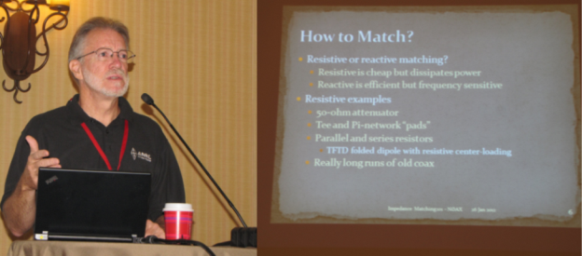
Forum Topics:
Technical Innovations & Advancements
On-The-Air Operating Activities
Public Service Communications
Education
Club Development and Support

Slide 18
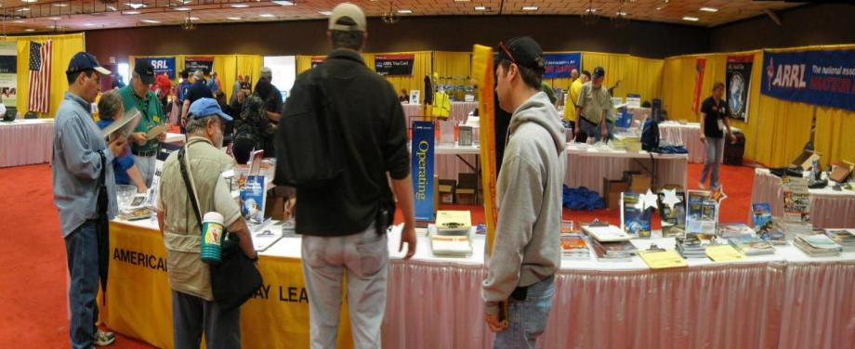
ARRL EXPO
ARRL EXPO is a showcase of ARRL exhibits, activities and programs that exemplify the best
of Amateur Radio.

Slide 19
Exhibits
Exhibitors will include manufacturers and retailers showcasing their latest products
and services.
These are just some of the exhibitors who are planning to attend:

Slide 21
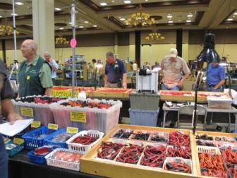
Flea Market
There will be an indoor
Flea Market at the
air conditioned Connecticut
Convention Center
Friday and Saturday.

Slide 22
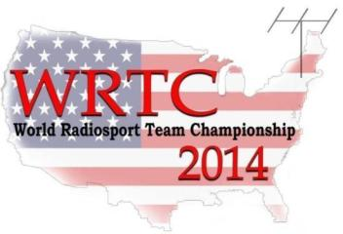
WRTC 2014
July 8th – July 15th
The World Radiosport Team Championship (WRTC) is held every four years.
59 two-person teams of Amateur Radio operators from at least 25 countries will compete in a test of operating skill.
Stations will use identical antennas and transmitter power from the same geographic region, eliminating all variables except operating ability.
Held in Massachusetts the week before the Convention: wrtc2014.org

Slide 23
International Reception
Thursday July 17
There will be a reception to welcome International visitors Thursday evening.
Tickets will be available
to anyone who would like
to attend.

Slide 24
Thursday July 17
Full and Half Day Forums
DX University
Contest University
Teacher Training on Wireless Technology
Club Support and Development
Public Service Communications Academy
Amateur Radio Satellites
RFI Seminar

Slide 25
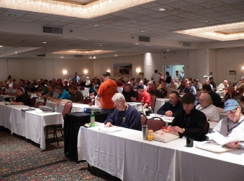
Thursday July 17
Full and Half Day Forums
There will be a special luncheon for all Seminar participants on Thursday.
Tickets will be available for anyone who wants to attend

Slide 26
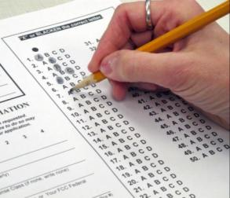
ARRL Centennial Convention
Friday July 18th
Opening Ceremony Friday Morning
Exhibits, ARRL Expo 9 am to 5 pm
Indoor Flea Market
Forums and Seminars
Licensing Exams all day
ARRL Headquarters and W1AW Tours
Hartford Bus Tours with on/off stops

Slide 27
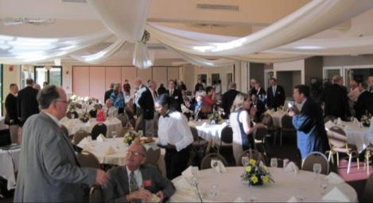
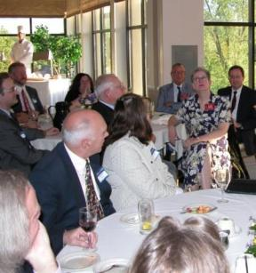
Friday Night Banquet
Culminate Friday’s Activities by Attending
Our Gala Banquet.

Slide 28
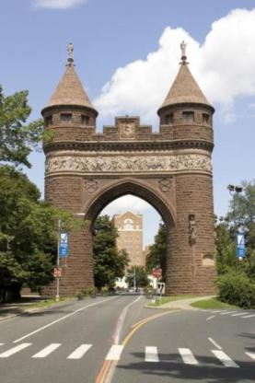
Saturday July 19th
Breakfast Program
at the Convention Center
Exhibits, ARRL Expo 9 am to 5 pm
Indoor Flea Market
Forums and Seminars
Licensing Exams all day

Slide 29
Saturday July 19th
ARRL HQ and W1AW Tours
Hartford Bus Tours with on/off stops
Wouff Hong Ceremony

Slide 30
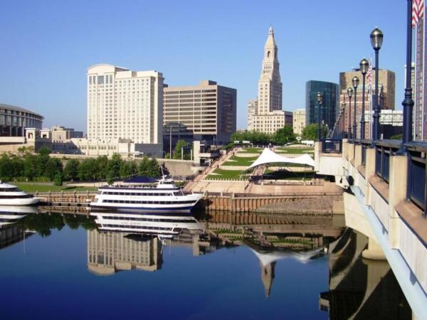
Bring Your Family & Friends
There are many family activities in the Hartford area

Slide 31
Hartford Area Attractions:
The Wadsworth Athenaeum

Slide 32
If you would like to volunteer
Or to present a program,
Visit: ARRL2014.org

Slide 33
Volunteers Wanted:
ARRL/W1AW HQ Assistance
Exhibitor Lounge
Forum Monitor
Greeters
Registration
Transportation
Wouff Hong Ceremony
Apply at ARRL2014.org

Slide 34
See you at the
ARRL Centennial Convention
July 17 – July 19, 2014
Hartford, Connecticut
ARRL2014.org

