Slide 1

Happy 100th Birthday
ARRL!
©ARRL 2013

Slide 2
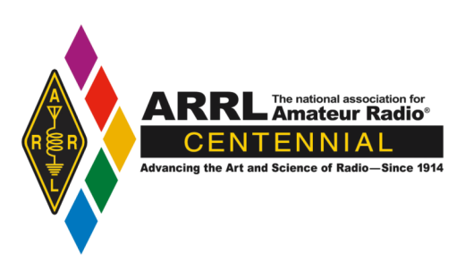
The ARRL Celebrates its 100th Birthday
in 2014

Slide 3
To celebrate this milestone,
The ARRL Centennial
Convention
will be held in
Hartford, Connecticut
July 17-20, 2014

Slide 4
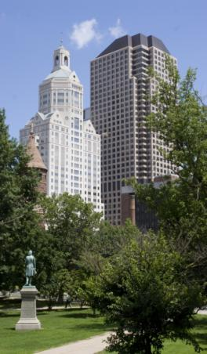
Why Hartford?
The ARRL was established in Hartford in 1914.
ARRL Headquarters and
W1AW are located in nearby Newington, Connecticut.
New England has many places
that are of historical significance to radio.

Slide 5
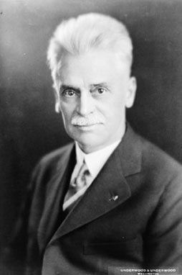
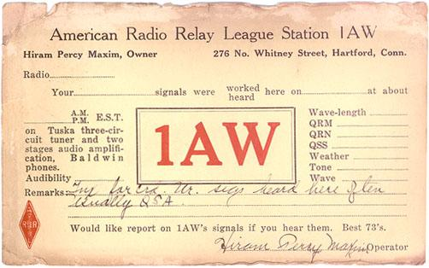

Why Hartford?

Slide 6
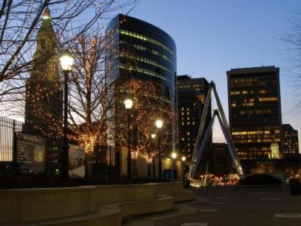
Why Hartford?
The Connecticut Convention Center is easily accessed from major interstates and airports.
Hartford is located between New York City and Boston.
The Hartford region
has a wealth of hotels, restaurants and other world-class attractions.

Slide 7
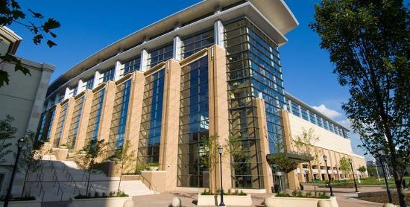

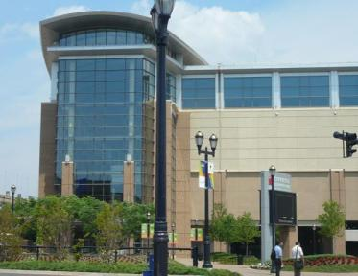
The Centennial Convention will be held
at the Connecticut Convention Center

Slide 8
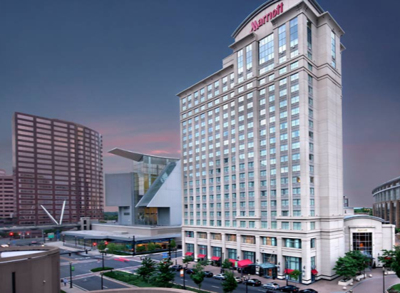
The Hartford Downtown Marriott
is the Headquarters Hotel and it is
attached to the Convention Center
Other hotels will be offering discounted
rates to convention attendees.

Slide 9
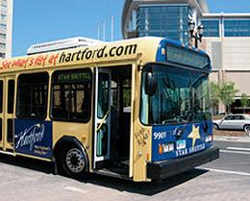
The Connecticut Convention Center
is located 15 minutes from
ARRL Headquarters.
Free shuttle buses will be available
between the two locations.

Slide 10
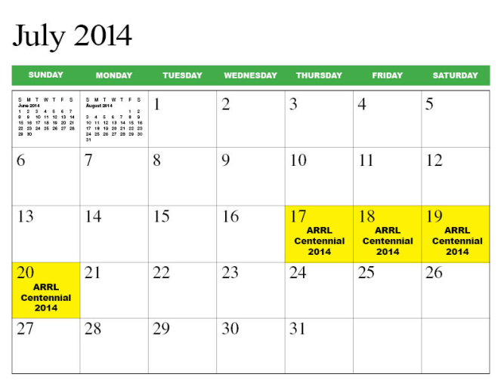
ARRL Centennial Convention

Slide 11
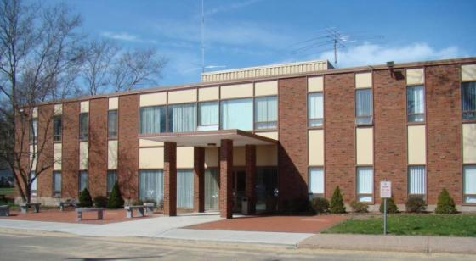
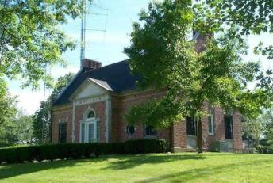
Visit ARRL Headquarters
and W1AW

Slide 12
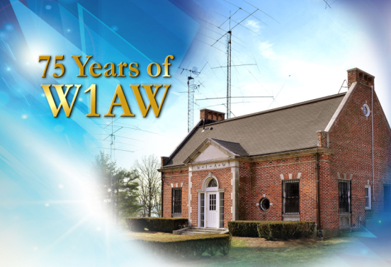
  ARRL Headquarters and W1AW
  Will Be Open the Weekend
  of the Convention
The Hiram Percy Maxim Memorial Station

Slide 13
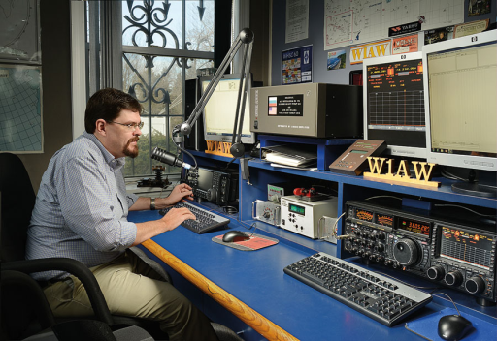
W1AW Will Be Open
for Guest Operators

Slide 14
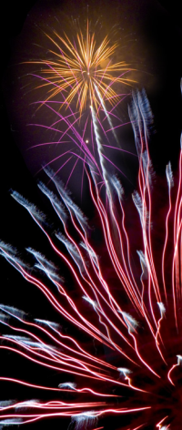
ARRL Centennial Convention
A Once in a Lifetime Opportunity to Celebrate
ARRL’s 100th Birthday
Have Fun and a Great Time!
Enjoy First Rate Exhibits
Hear VIP Speakers and Presentations
Attend National Meetings for Amateur Radio Groups and Organizations

Slide 15
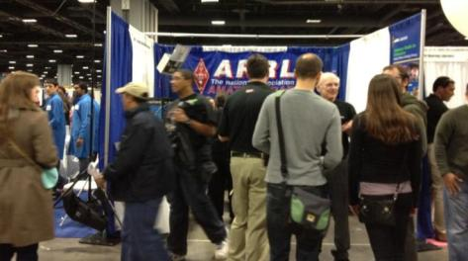
ARRL Centennial Convention
Learn at World Class Seminars and Forums
Showcase Amateur Radio and the ARRL
Meet Amateurs and Friends from Around
the World and from Around the Corner
Meet Who’s Who in Amateur Radio

Slide 16
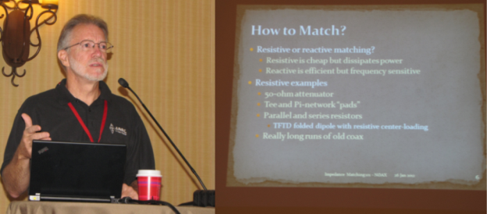
Forum Topics:
Technical Innovations & Advancements
On-The-Air Operating Activities
Public Service Communications
Education
Club Development and Support

Slide 17
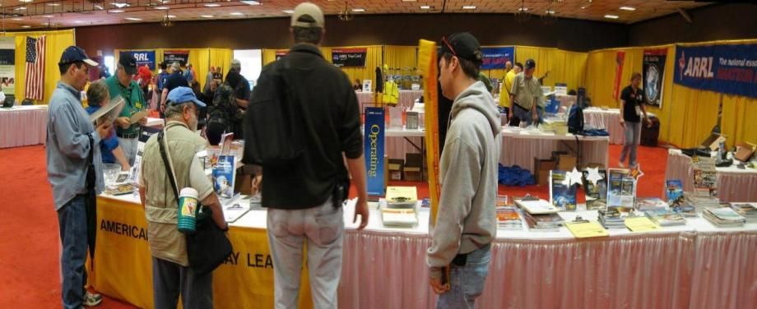
ARRL EXPO
ARRL EXPO is a showcase of ARRL exhibits, activities and programs that exemplify the best
of Amateur Radio.

Slide 18
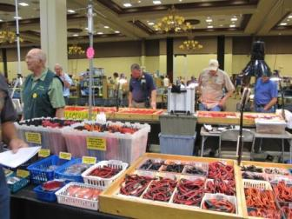
Exhibits and Flea Market
Exhibitors will include manufacturers and retailers showcasing their latest products
and services.
There will be an indoor
Flea Market at the
air conditioned
Convention Center
Friday and Saturday.

Slide 19
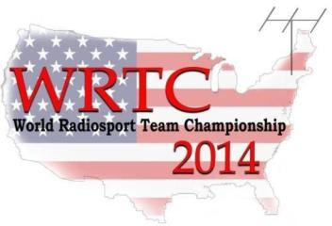
WRTC 2014
July 8th – July 15th
The World Radiosport Team Championship (WRTC) is held every four years.
59 two-person teams of Amateur Radio operators from at least 25 countries will compete in a test of operating skill.
Stations will use identical antennas and transmitter power from the same geographic region, eliminating all variables except operating ability.
Held in Massachusetts the week before the Convention: wrtc2014.org

Slide 20

International Reception
Thursday July 17
There will be a reception to welcome International visitors Thursday evening.
Tickets will be available
to anyone who would like
to attend.

Slide 21
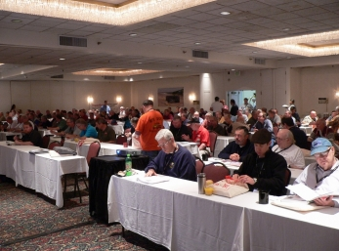
Thursday July 17
Full and Half Day Forums
DX University
Contest University
Teacher Training on Wireless Technology
Club Support and Development
Public Service Communications Academy

Slide 22
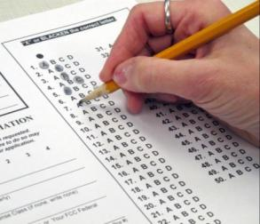
ARRL Centennial Convention
Friday July 18th and Saturday July 19th
Opening Ceremony Friday Morning
Exhibits, ARRL Expo 9 am to 5 pm
Indoor Flea Market
Forums and Seminars
Licensing Exams all day
Hartford Bus Tours with on/off stops
ARRL Headquarters and W1AW Tours

Slide 23
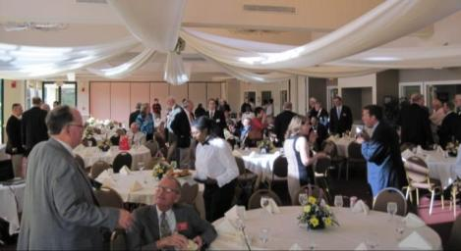
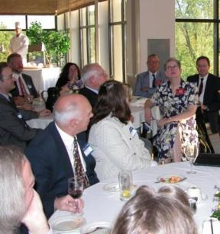
Friday Night Banquet
Culminate Friday’s Activities by Attending
Our Gala Banquet.

Slide 24
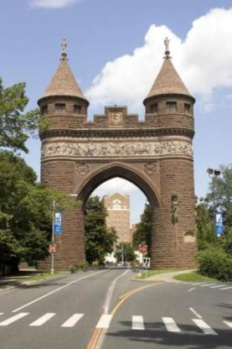
Saturday July 19th
Early morning 5K Fun Run/Walk through the downtown Hartford Capitol area
Breakfast Program
at the Convention Center
Wouff Hong Ceremony

Slide 25
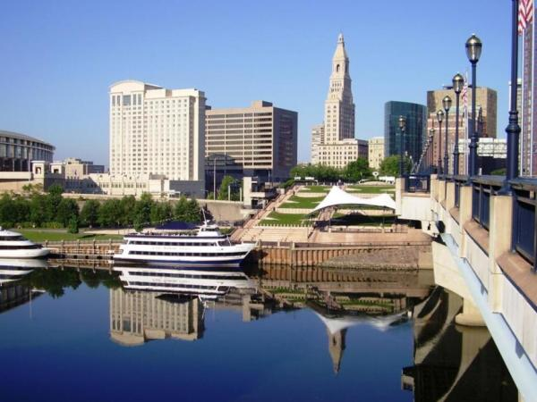
Bring Your Family & Friends
There are many family activities in the Hartford area

Slide 26








Hartford Area Attractions:
The Wadsworth Athenaeum

Slide 27

If you would like to volunteer
Or to present a program,
Visit: ARRL2014.org

Slide 28
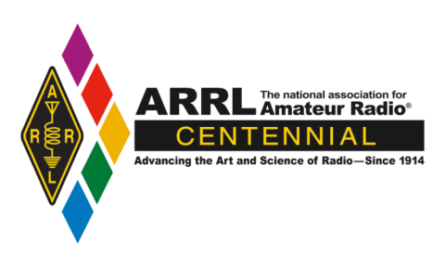
See you at the
ARRL Centennial Convention
July 17 – July 20, 2014
Hartford, Connecticut
ARRL2014.org

