Slide 1
© ARRL 2015

Slide 2
ARRL’s Mission Statement:
To advance the art, science, and enjoyment of Amateur Radio.

Slide 3
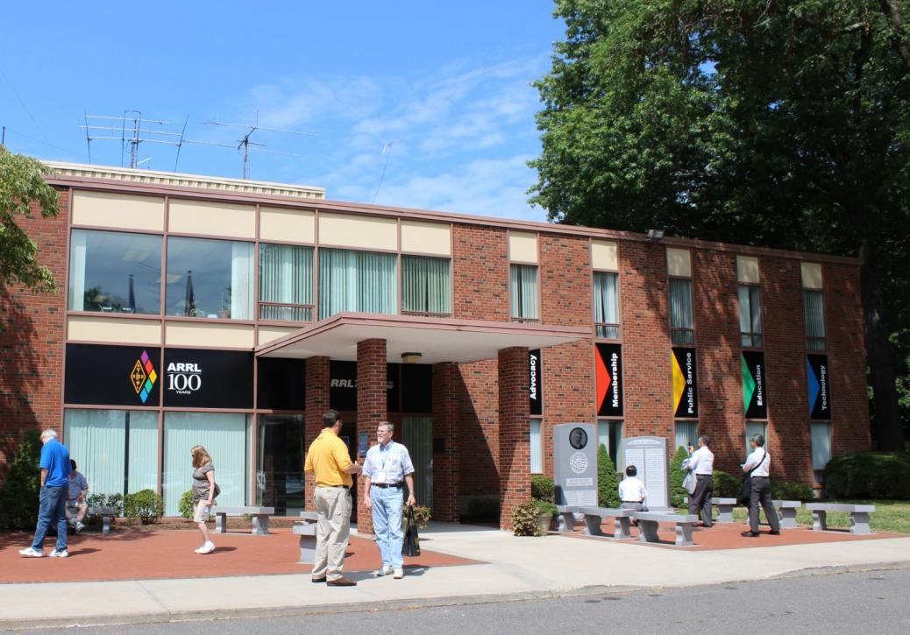
ARRL Headquarters
225 Main Street Newington, Connecticut

Slide 4
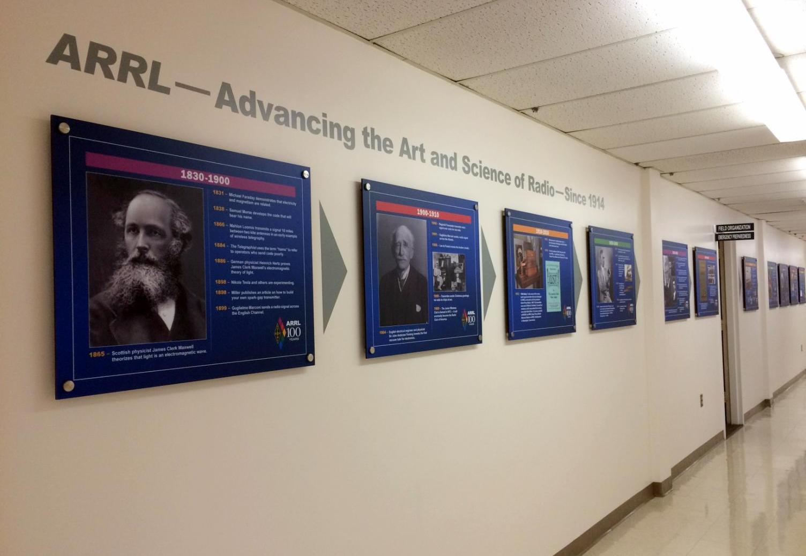
ARRL Headquarters

Slide 5
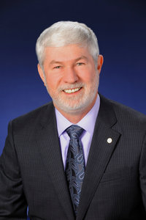
Chief Executive Officer
Howard Michel WB2ITX- CEO
Regulatory,
Spectrum Management,
Advocacy,
Government and Public Relations
HQ Management

Slide 6
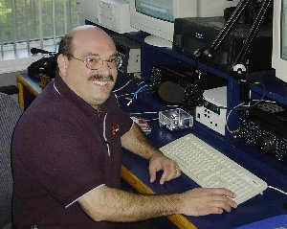
Operations
Radiosport-Field Services
Production - Editorial
Regulatory Affairs
VEC
ARRL Lab
Norm Fusaro, W3IZ
Director of Operations

Slide 7
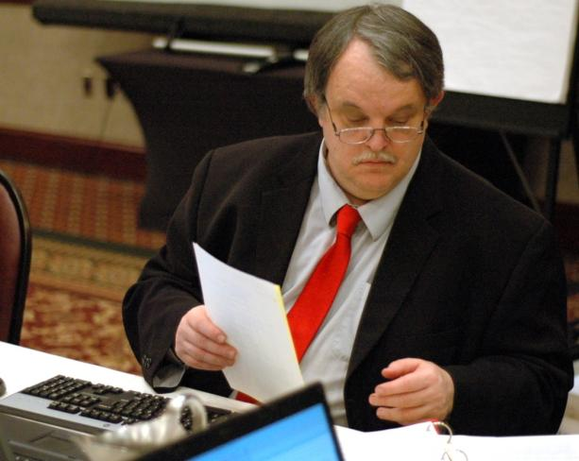
Regulatory Information
Dan Henderson, N1ND
Assistant Secretary
Manager, Regulatory Affairs
Member and FCC Liaison Antenna Issues FCC Rule Book Volunteer Counsel and Engineers

Slide 8
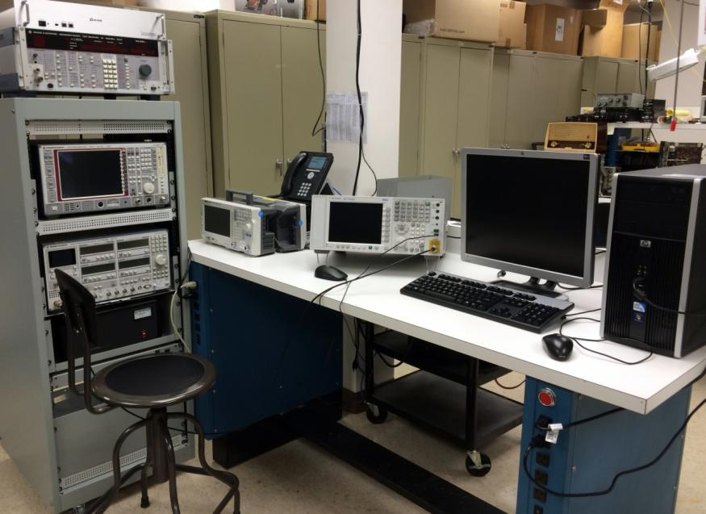
The ARRL Lab
- Product Review - Technical Information Services - RFI Issues - Industry Regulatory Support

Slide 9
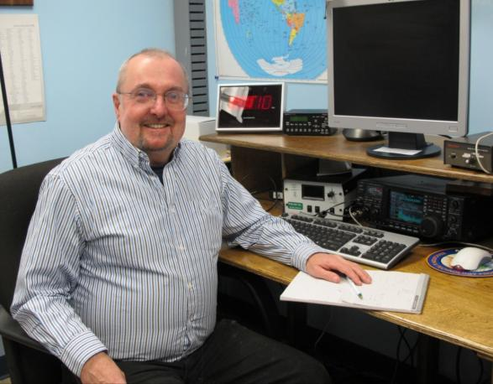
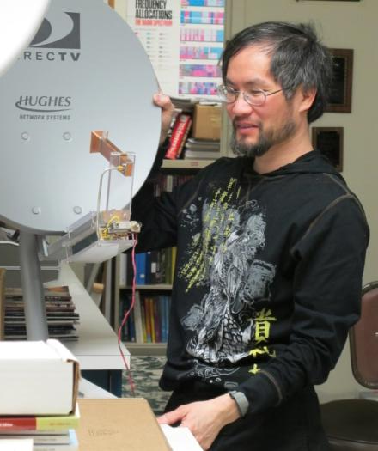
ARRL Lab Staff
Ed Hare, W1RFI
Lab Manager
Zack Lau, W1VT
Technical Support Engineer

Slide 10
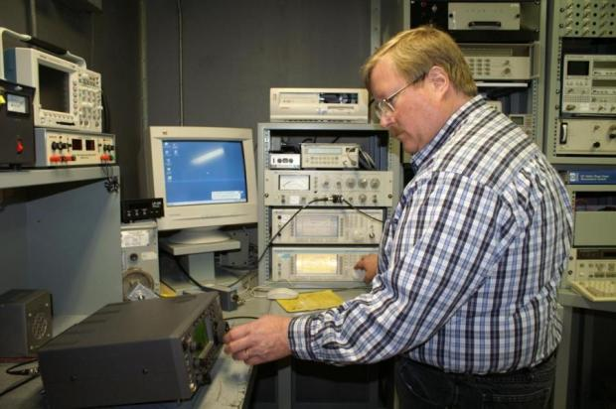
Lab Staff
Bob Allison, WB1GCM
Senior Test Engineer
QST Product Review

Slide 11
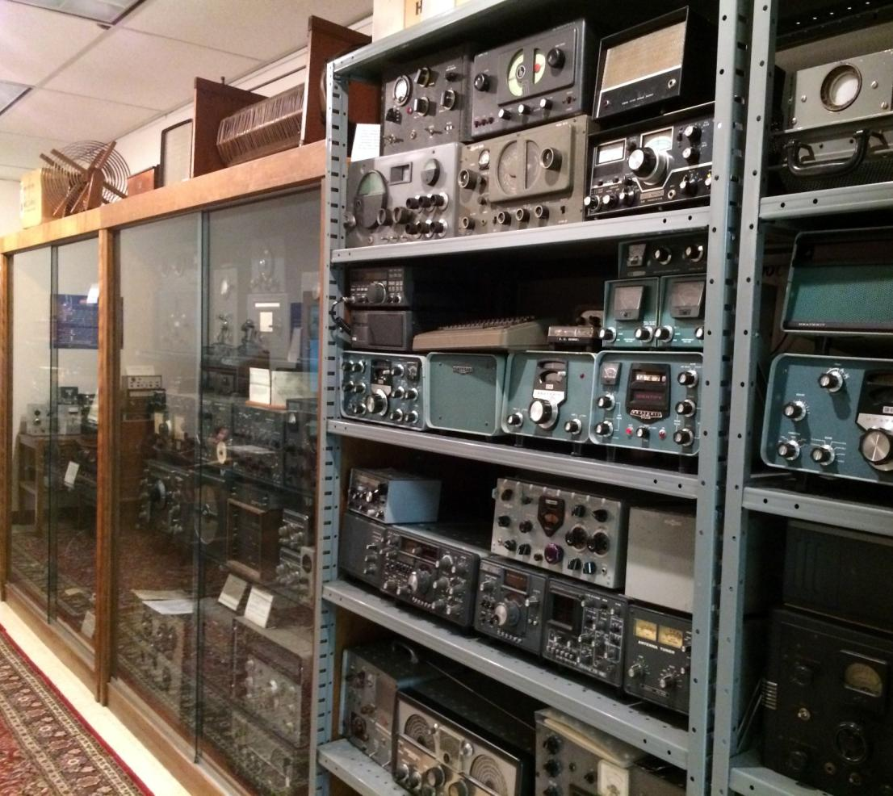
Exhibit

Slide 12
ARRL Education Services Dept.
- ARRL Instructor Support
- Teachers Institutes
- Education and Technology Program
ARISS
- Radio Waves Newsletter
If you need help or resources teaching
a licensing course.

Slide 13
Field Services Department ▪
Field Services
Emergency Preparedness
W1AW
OO Program
Convention Programs

Slide 14
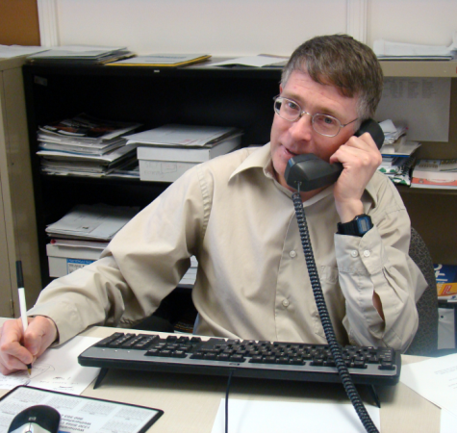
FSR Department ▪ Field Support
Steve Ewald, WV1X
Field Support Staff Supervisor

Slide 15
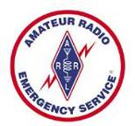
Amateur Radio Emergency Service ▪ ARES
- Field Organization
- 9,000 + Volunteer Leaders
- SM, SEC, DEC, EC
- Support, Training, Organization
- Free Monthly ARES E-Newsletter

Slide 16
Amateur Radio Emergency Service ▪ NTS
- Field Organization
- SM, STM, NM, ORS
- Support, Training, Organization
- Under study for upgrades

Slide 17
Partners
FEMA
American Red Cross
The Salvation Army
NPSTC
MARS
REACT
Skywarn
And many others

Slide 18
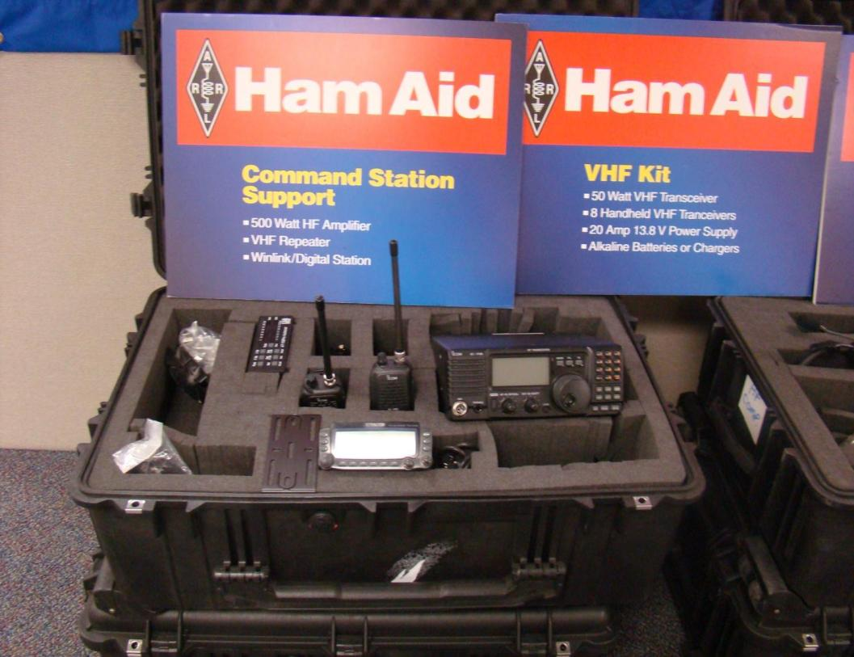
Ham Aid

Slide 19
Field Day

Slide 20
DXCC
Typically in a year:
1.1 million credits processed
13,500 applications received
The number of DXCC applications have gone up every year for the past ten years!

Slide 21
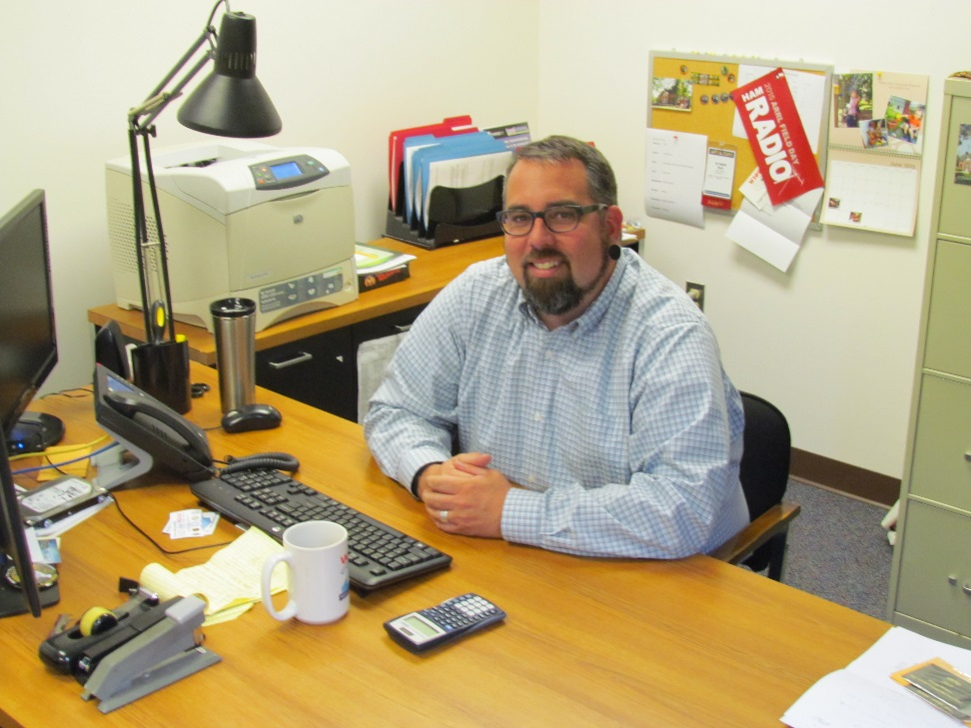
Contest Branch
Operating Events and
Contests
- 15 contests per year
- 24 operating events per year
Contest Branch Manager
Matt Wilhelm, W1MSW

Slide 22
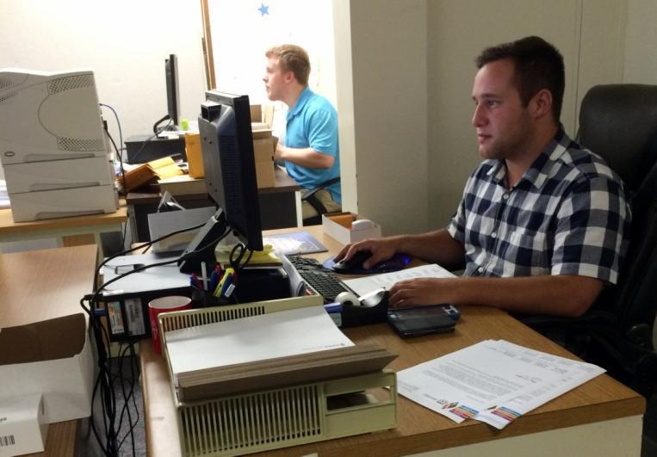
Radiosport Department ▪ Awards Branch
Award questions on:
- Rules
Award Applications
Award Status

Slide 23
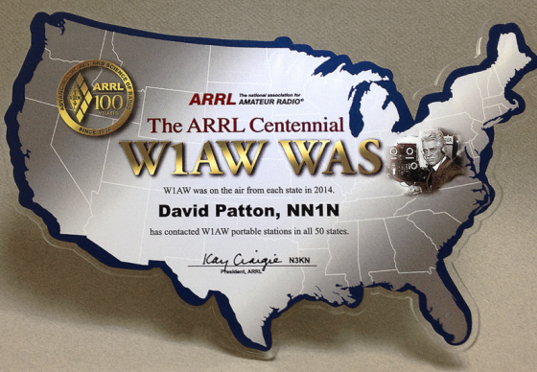
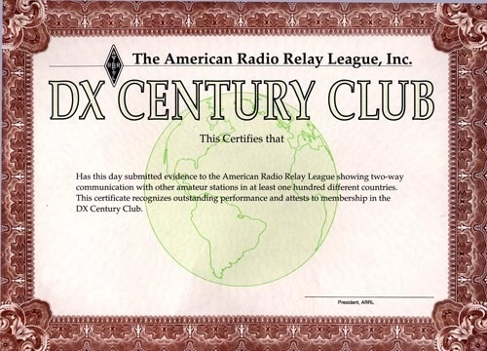
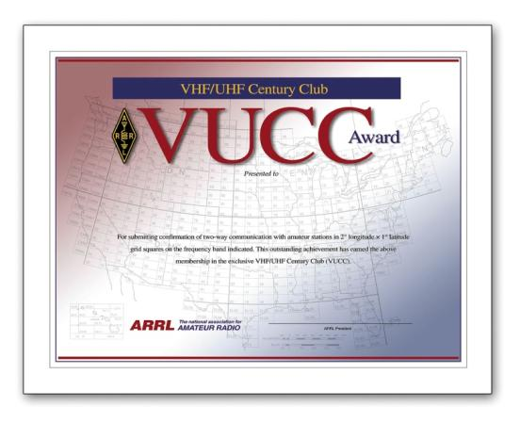
ARRL Awards

Slide 24
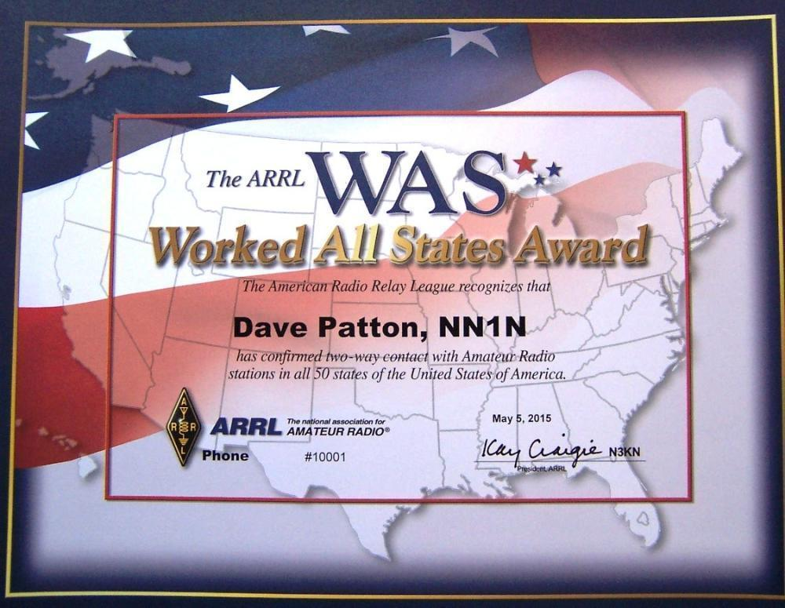
Worked All States Certificate

Slide 25
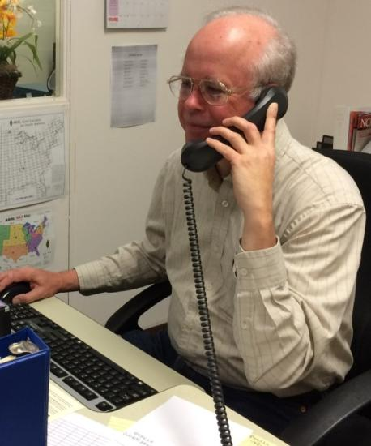
120,248 Users ▪ 1,066,308,545 QSO Records
Dan Wall, W1ZFG
Logbook Support

Slide 26
ARRL Affiliated Clubs

Slide 27
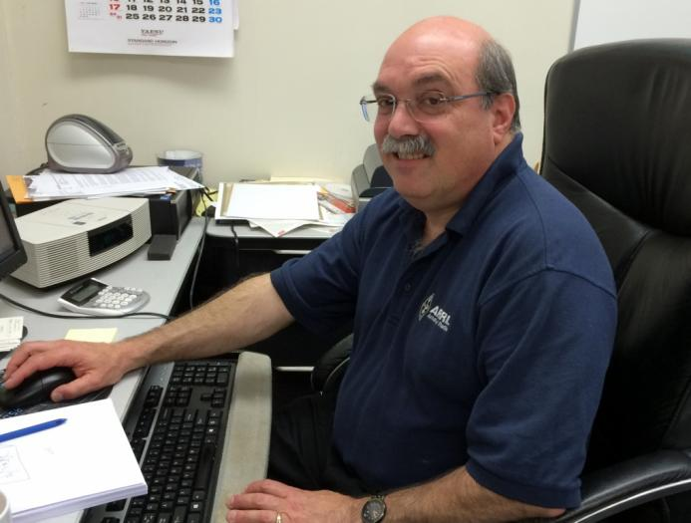
Club Support
2,300 ARRL Affiliated Clubs
Norm Fusaro, W3IZ , Club Support

Slide 28
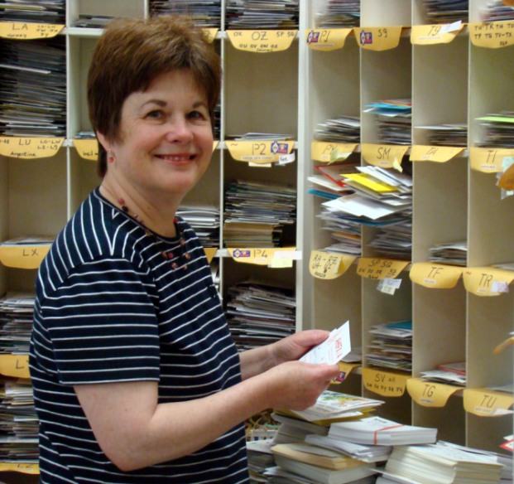
The ARRL Outgoing QSL Service
Rose-Anne Lawrence KB1DMW
Processes more than 800,000 QSLs annually

Slide 29
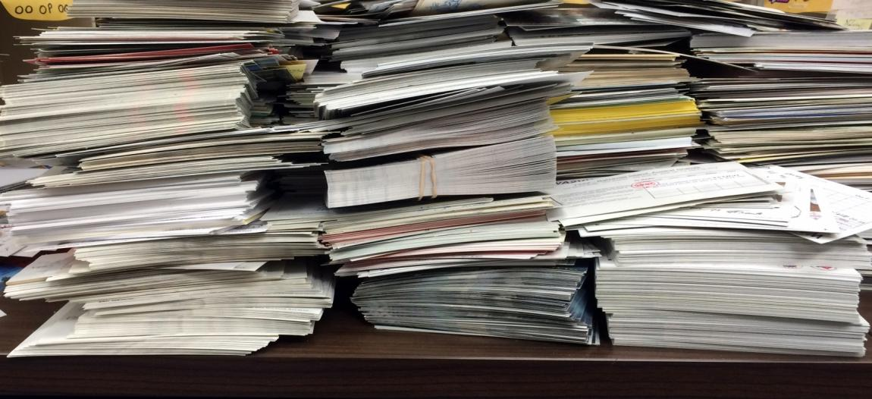
The ARRL Outgoing QSL Service
Rose-Anne Lawrence KB1DMW
About 2 Tons of Cards Shipped in 2016!

Slide 30
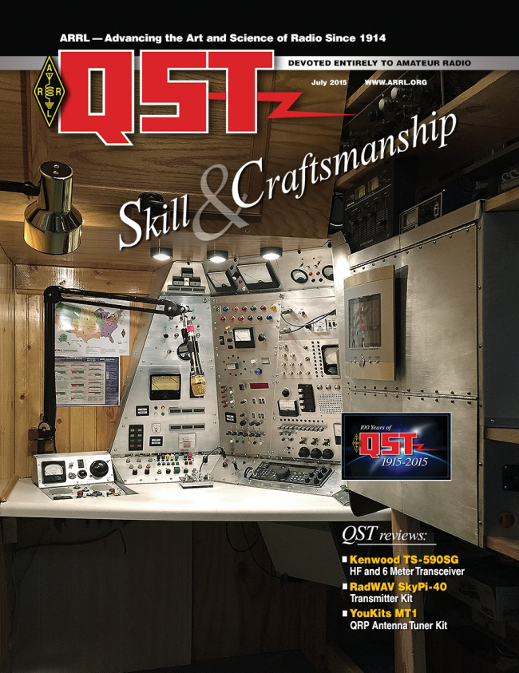
ARRL Publications
Print and Digital Editions

Slide 31
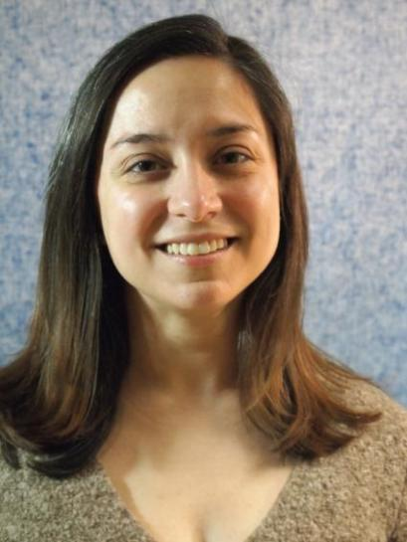
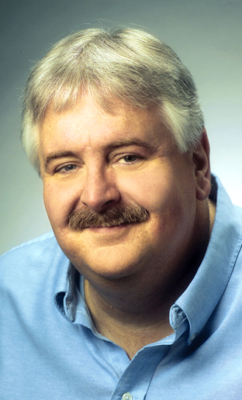
ARRL Publications
Becky Schoenfeld, W1BXY
Managing Editor, QST
Steve Ford, WB8IMY
Manager ARRL Publications

Slide 32
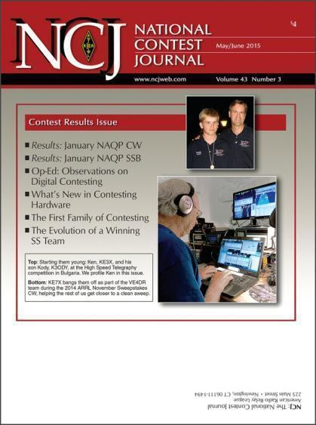
QEX ▪ NCJ

Slide 33
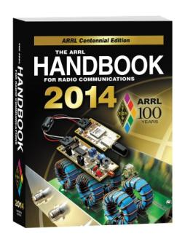
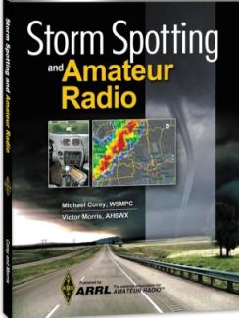
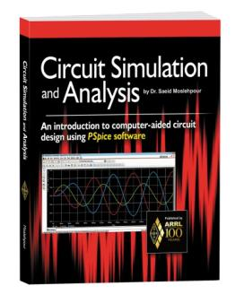
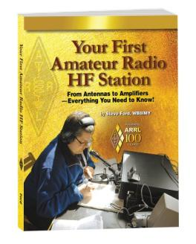
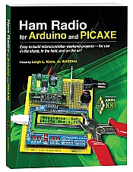
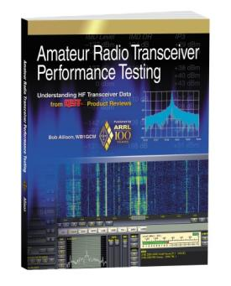
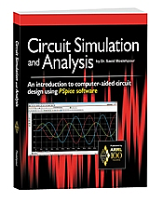
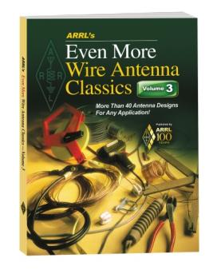
150 Books

Slide 34
Electronic Newsletters
ARRL Letter
ARES E-Letter
ARRL Contest Update
Radio Waves
Instructor’s Newsletter
Legislative Update
Contact –Public Relations
VEC News

Slide 35
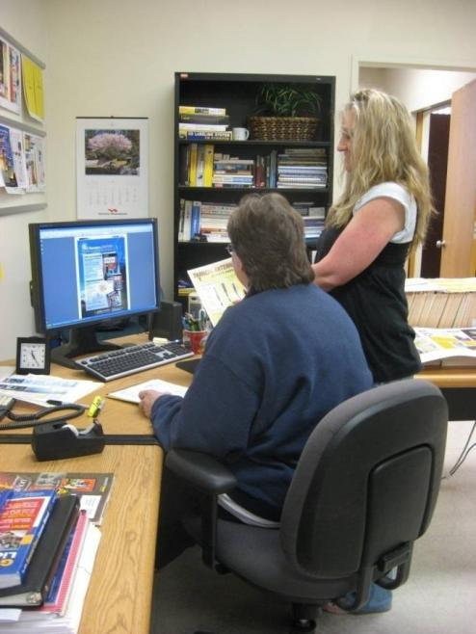
ARRL Business Services
- Advertising Sales for:
- QST ▪ NCJ ▪ QEX
- ARRL Publications
- E-Newsletters
- Wholesale Book Dealers
Janet Rocco W1JLR
Advertising Sales Manager

Slide 36
Advertising

Slide 37
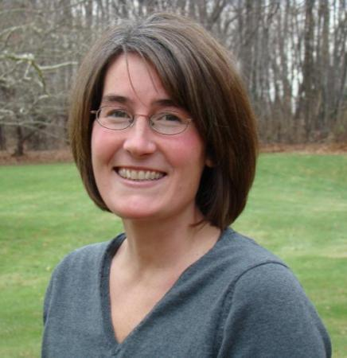
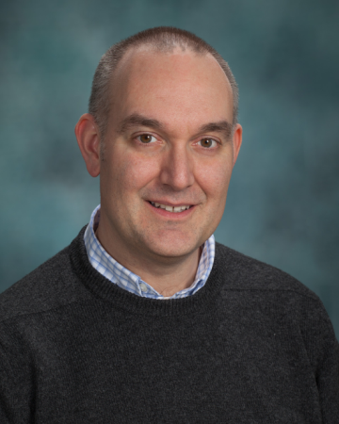
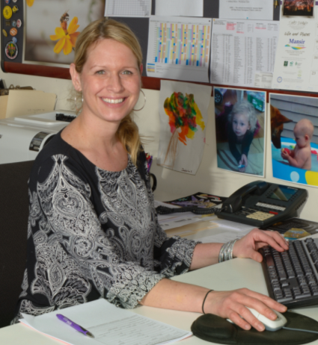
Marketing and Membership
Diane Petrilli, KB1RNF Membership Manager
Bob Inderbitzen, NQ1R Department Manager
Yvette Vinci, KC1AIM
Circulation Manager

Slide 38
Marketing and Membership
Excellence in serving members
and customers is our #1 Priority!

Slide 39
Marketing and Membership
Questions about:
- Membership
- Circulation (QST ▪ NCJ ▪ QEX)
- Publications and Product Sales
- Order Fulfillment
- Customer Service

Slide 40
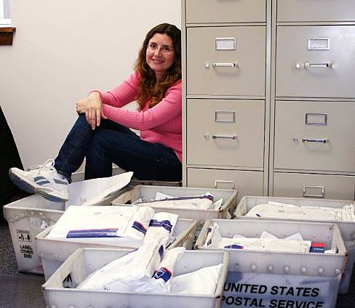
Volunteer Exam Coordinator (VEC)
Maria Somma, AB1FM
VEC Manager
Perry Green, WY1O
Assistant Manager

Slide 41
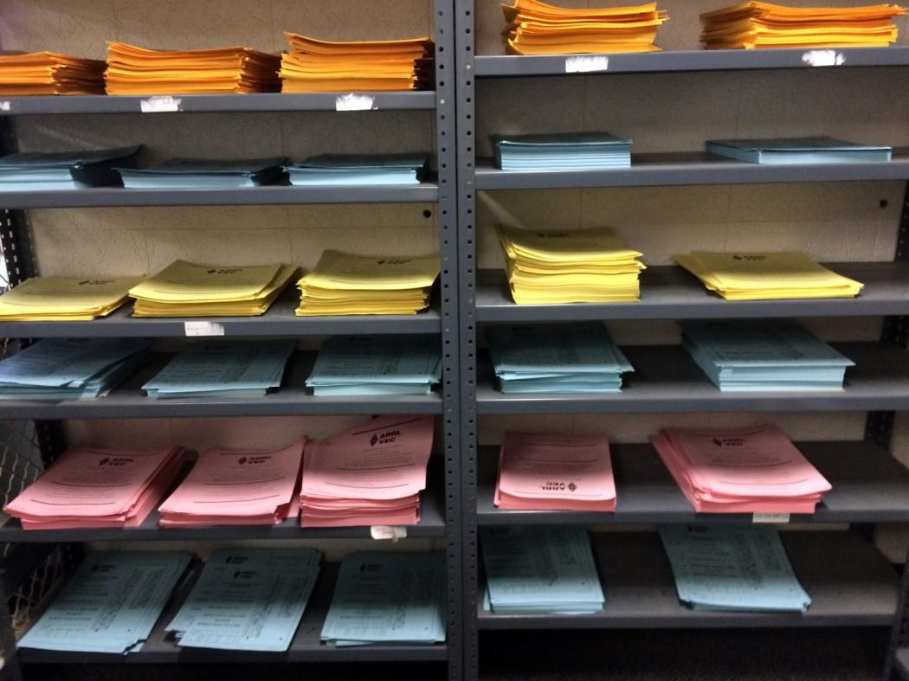
Volunteer Exam Coordinator (VEC)

Slide 42
Volunteer Exam Coordinator (VEC)
ARRL VEC administers 75% of all Amateur Radio exams
37,500 Volunteer Examiners
Over 51,000 exam elements administered annually
7,200 + sessions in 2016

Slide 43
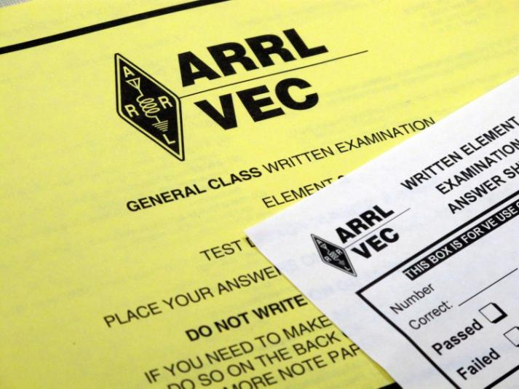
Volunteer Exam Coordinator (VEC)
Questions:
- Where do I go to take the test?
- When will my license be issued?
- How do I renew my license?
- How do I get a vanity call sign?

Slide 44
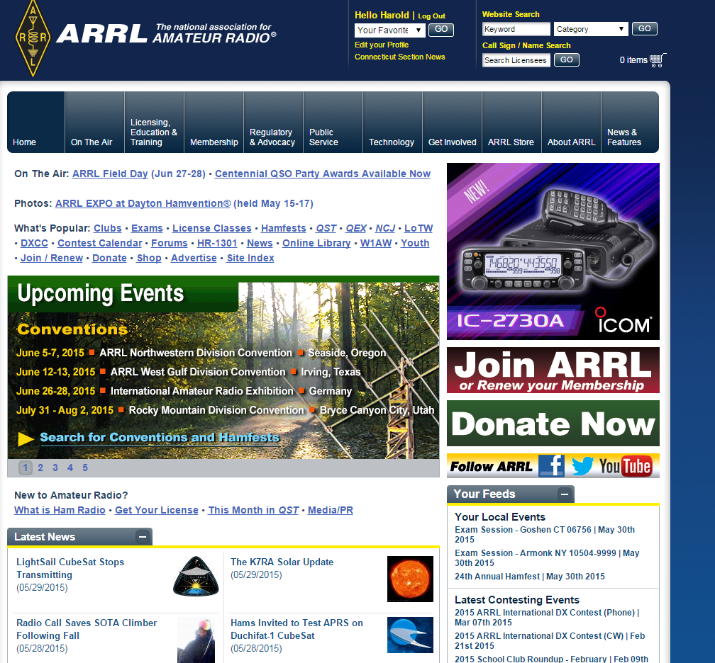

Slide 45
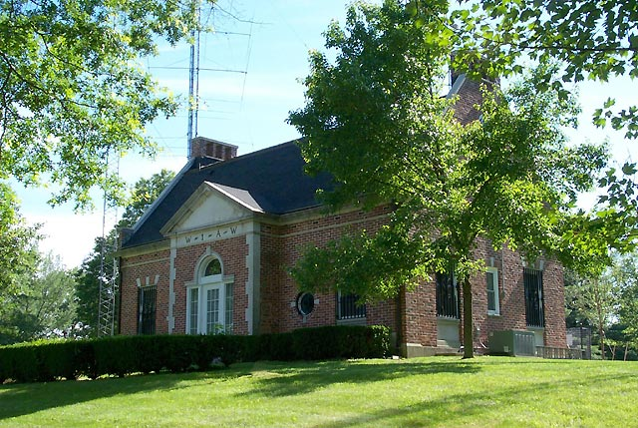
W1AW
W1AW
The Hiram Percy Maxim Memorial Station
W100AW made about 70,000 QSOs in 2014

Slide 46
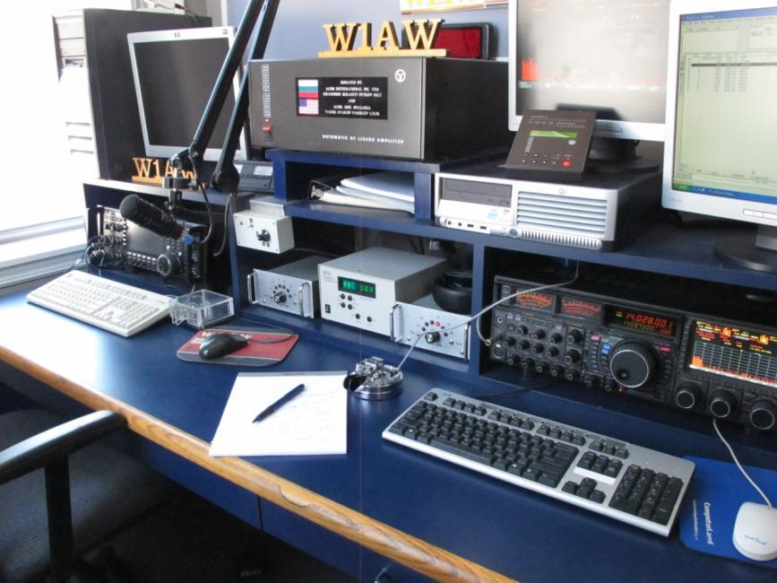
W1AW Operating Studios
Open for Visitors and Guests

Slide 47
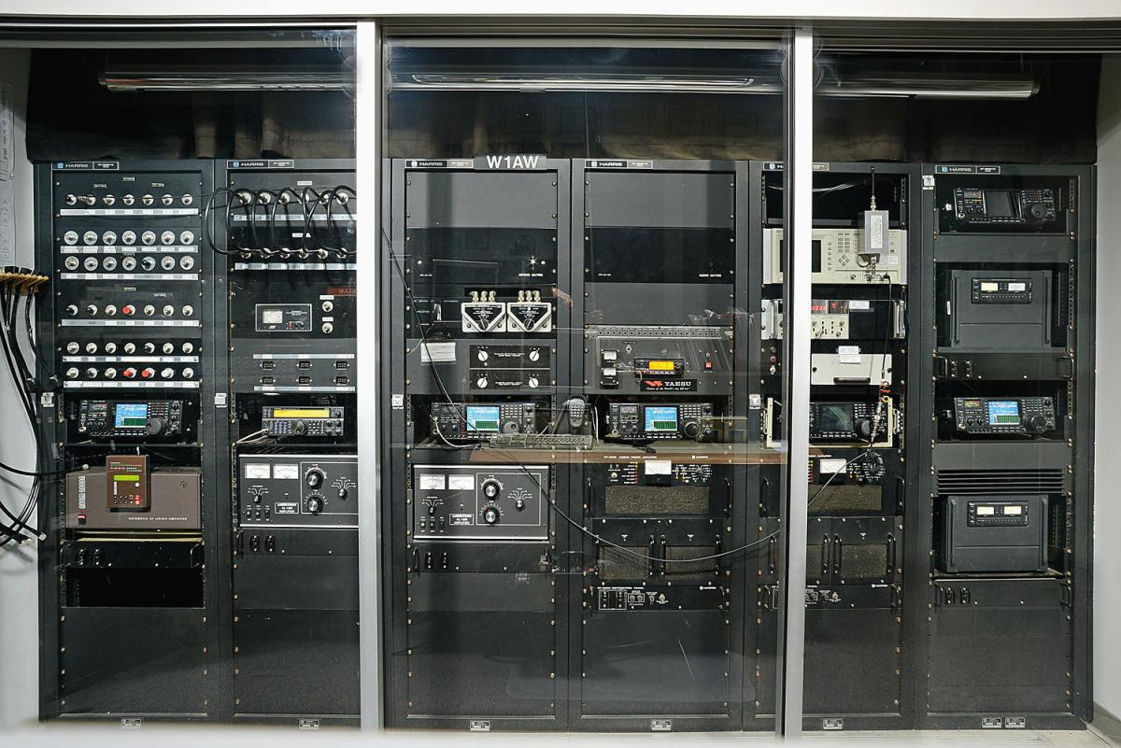
W1AW Broadcast Equipment

Slide 48
ARRL Information Technology Team

Slide 49
Additional ARRL Staff
- ARRL Mail Room
- ARRL Warehouse
- Building Management
- CFO Staff / Accounting / HR
- Writers, Editors & Columnists

Slide 50
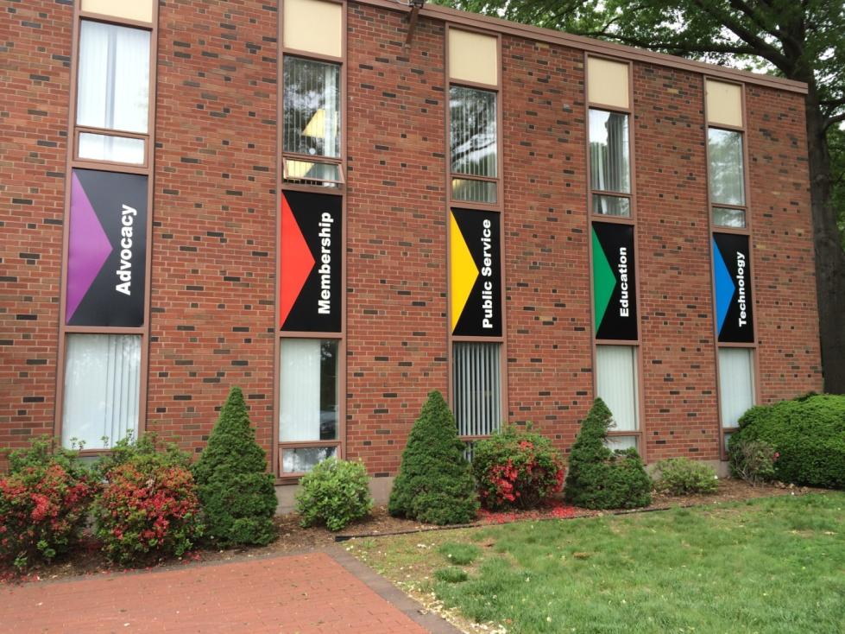
On behalf of all of us at ARRL, we thank you for your support.

Slide 51
So where do we go from here?
Parity Act
Working with staff and lobbyists to update the text of the bill.
CAI is mounting heavy opposition

Slide 52
So where do we go from here?
DXCC Card Checkers
Rules updates
Process to replace inactive checkers
More checkers – strategically located
Available to more hams
More 160 Meter Field Checkers

Slide 53
So where do we go from here?
ARES Updates Completed
EC is the person on the front line
Full knowledge of needs in the field
Alignment with NIMS
EC at top of hierarchy
All other ARES appointees support the EC

Slide 54
So where do we go from here?
ARES Updates
Our Partners require training
Confident about ARES capabilities
Know where ARES Fits
Selling the program
ARRL HQ works at top levels
Details agreement with Partners
Based upon ARES capabilities, capacity, credentials, qualifications

Slide 55
So where do we go from here?
ARES Reporting traditionally ineffective
New web based reporting system
ARES Connect
Each ARES Unit has its own pages
Includes event calendar
Members are all registered
EC can use database off line
Members training records included

Slide 56
So where do we go from here?
National Traffic System
The Foundation of ARRL
Showing Limited Growth
Low Activity Levels
Needs better interface in disasters
Under Study by PSEWG
Recommendations due in 2020.

Slide 57
So where do we go from here?
Amateur Radio Growth
Where does it come from?
Youth?
Young Adults?
New ham retention
Mentoring
We fail miserably at this !!!

Slide 58
So where do we go from here?
Entry Level License
Team in place to look at need
Type, Qualifications, Access
Review of field study
Advantages
Disadvantages
Decision & Recommendation
FCC states “No new license levels”
Current Techs “sequestered” – no access to active HF bands….

Slide 59
So where do we go from here?
Greater Outreach
College Clubs
Schools
Corporate funding for Programs
Replace Legacy IT systems
Improve Internal Processes
More Accountability
Timely Decisions

Slide 60
So where do we go from here?
New FCC monitoring Program
About 250 selected Monitoring Stations
Tested
Vetted Approved by FCC
Managed by former FCC Official Riley Hollingsworth K4ZDH

Slide 61
So where do we go from here?
Key July Board Actions
Voted to oppose French proposal to allocate 144-146 MHz to aircraft.
Added QRP operating to the RTTY Roundup.
Directed counsel make appropriate filings with FCC relating to Automatically Controlled Digital operation.

Slide 62
So where do we go from here?
Questions and comments !!

Slide 63
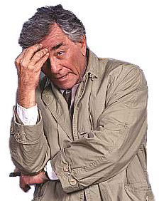
OOPS, now wait a moment…..

Slide 64
OOPS, now wait a moment…..
Just what does ARRL do for me?

Slide 65
WIIFM (What’s in it for me?)
Advocacy Programs
PRB-1 and Antenna Protection Legislation
Lobbies for spectrum protection - Intruders
Lobbies for additional bands. - WARC and VLF
Represents the interests of US hams at IARU
Rules Enforcement - Amateur Auxiliary and New FCC Monitoring Program

Slide 66
ARRL Laboratory
Technical Information Service
Tests new equipment and provides reports
RFI Assistance
Provides Social Media Programming
W1AW - Training and Bulletins
VEC – examinations
Free license renewal service

Slide 67
Publications - Technical and Operating Journals
QST Monthly Journal
QEX and NCJ Bi-Monthly Journals
QSL Service - incoming and outgoing
Training Courses
Technician Licensing
General Licensing
Teachers Institute

Slide 68
Volunteer Counsel Program
Volunteer Consulting Engineer Program
Technical Specialists
Volunteer Instructors
Electromagnetic Compatibility Committee
RF Safety Committee
ARRL Outreach Program
Youth
Schools

Slide 69
ARRL Foundation - Scholarships
Heritage Museum
NTS
ARES
Public Service Honor Roll
LoTW

Slide 70
On the Air Awards
DXCC
WAS
WAS
VUCC
A-1 Operator Club
Triple Play
Fred Fish Memorial Award
Morse Code Proficiency
Elmer Award
First Contact Award

Slide 71
Contests
Straight Key Night
Kids Day
RTTY Roundup
January VHF
School Club Roundups
International DX, CW and Phone
June VHF
Field Day

Slide 72
IARU HF World
222 MHz and Up
10 GHz and Up
Rookie Roundup RTTY
EME 23 GHz and Up
EME 50-1296
Nov Sweepstakes CW and Phone
160 Meter Contest
10 Meter Contest
Rookie Roundup - CW

Slide 73
Contact Information:
ARRL Great Lakes Division Director Dale Williams WA8EFK wa8efk@arrl.net ARRL Great Lakes Division Vice Director Tom Delaney W8WTD w8wtd@arrl.net

Slide 74
Questions and comments !!

